Slide 1
N-BEATS: Time-Series Forecasting with Neural Basis Expansion
Boris N. Oreshkin, Dmitri Carpov, Nicolas Chapados, Yoshua Bengio
International Conference on Learning Representations, 2020
Presented by Group 8
Madhav Bajaj
Aditya Agarwal
Siddarth Mamidisetti
Rishi Jain Arvind Iyer

Slide 2
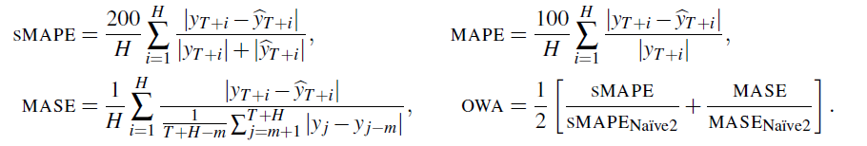
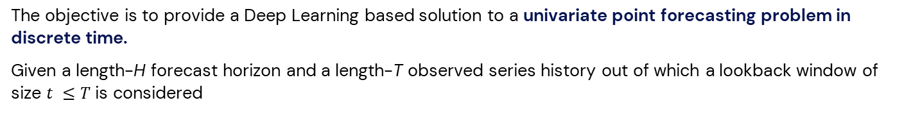
Problem Statement
The objective is to provide a Deep Learning based solution to a univariate point forecasting problem in discrete time.
Given a length-H forecast horizon and a length-T observed series history out of which a lookback window of size $t ≤T$ is considered
$$x ∈ ℝ^{t}=\left[y_{T−t+1} , … , y_{T}\right]$$
The task is to predict the vector of future values
$$y ∈ ℝ^{H}=[y_{T+1},… , y_{T+H}]$$
Let $\hat{y}$denote the forecast of $y$, then the following metrics will be used to evaluate the performance of the model
MAPE (Mean Absolute Percentage Errors), sMAPE (Symmetric MAPE), MASE (Mean Absolute Scaled Error), OWA (overall weighted average).
m is the periodicity of data
Naïve predictor simply copies the observation measured m periods in the past

Slide 3
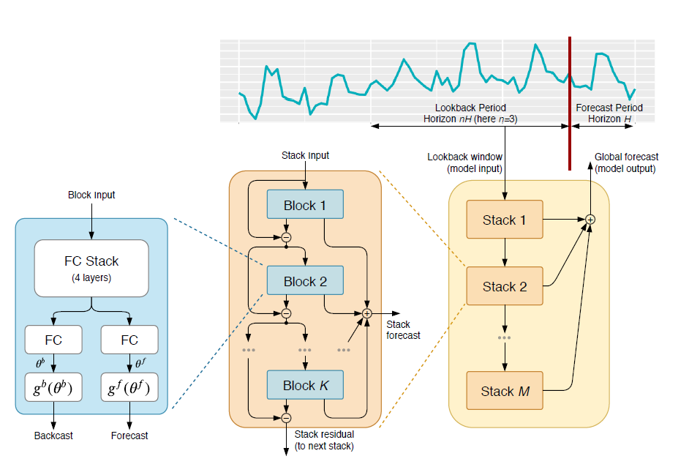








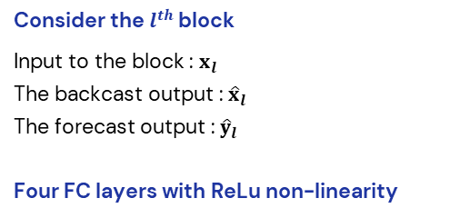
Architecture - I
Consider the $l^{th}$ block
Input to the block : $x_{l}$
The backcast output : ${\hat{x}}_{l}$
The forecast output : ${\hat{y}}_{l}$
Four FC layers with ReLu non-linearity
Linear Projection Layer
and are forward and backward expansion coefficients
Basis Layer
The basic block

Slide 4





Architecture - II
Double Residual Stacking
Basis Layer
Here, $v_{i}^{f}$ and $v_{i}^{b}$ are forecast and backcast basis vectors
Selection of and which provide sets and
provides two architectures
Generic Architecture
No reliance on time-series domain knowledge and not interpretable
Interpretable Architecture
Introduce trend and seasonality decomposition into the model to make the model outputs more easily interpretable

Slide 5








Architecture - III
Interpretable Architecture
Introducing subscript s in the notation for variables to denote the stack index
Trend Model
Seasonality Model
Constraining and to be a polynomial of small degree p to mimic trend.
Constraining and to belong to a class of periodic functions to mimic seasonality.
Alternatively
Alternatively

Slide 6
Dataset Description
M4¹ competition provided a large and diverse 100k-series dataset consisting of data frequently encountered in business, financial and economic forecasting and sampling frequencies ranging from hourly to yearly.
Power consumption in India(2019-2020) - Data is in the form of a time series for a period of 17 months beginning from 2nd Jan 2019 till 23rd May 2020. Rows are indexed with dates and columns represent states. Rows and columns put together, each datapoint reflects the power consumed in Mega Units (MU) by the given state (column) at the given date (row).
TOURISM³ dataset was released as part of the respective Kaggle competition conducted by Athanasopoulos & Hyndman (2011). The data include monthly, quarterly, and yearly series supplied by governmental tourism organizations (e.g., Tourism Australia, the Hong Kong Tourism Board, and Tourism New Zealand) and various academics who had used them in previous studies.
S. Madridakis et al., The M4 Competition: 100,000 time series and 61 forecasting methods, International Journal of Forecasting, 2020
S. Madridakis, M. Hibbon, The M3-Competition: results, conclusions and implications, International Journal of Forecasting, 2000
Athanasopoulos et al., The tourism forecasting competition, 2011

Slide 7
M4 Dataset

Slide 8
Dataset Preprocessing
M4 dataset
The M4 dataset consists of 100,000 data sequences
Given that we training would take a really long time we’ve decided to use a part of this dataset - Hourly Forecasting dataset
This Hourly Dataset consists of 414 data sequences
Each Data Sequence consists of a maximum of 900 data points
Dataset Used : M4 Dataset
Number of Data-Sequences : 414
Number of Data-Points : 700 Dropped the columns which have null values and normalized the Data Points
Train - Test Split : 80 - 20 (80% Train, 20% Test)

Slide 9
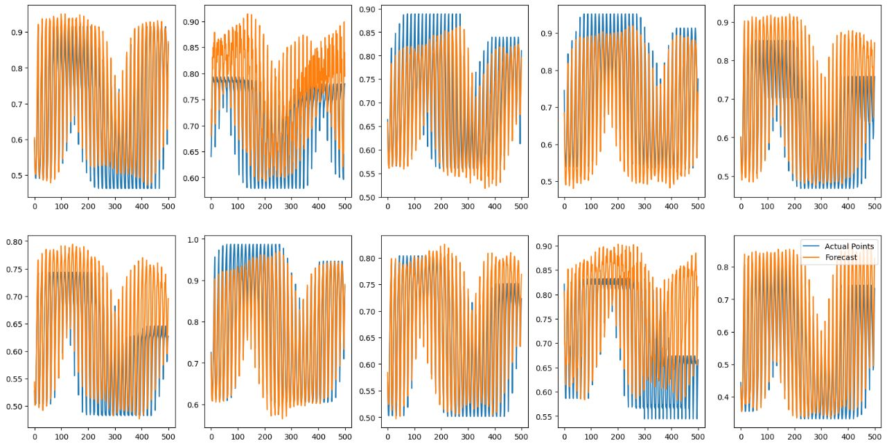
Results and Loss Plots - I
Dataset used to evaluate - M4(Hourly data)
OWA : 0.47949655455124734
sMAPE : 10.946776043391731

Slide 10
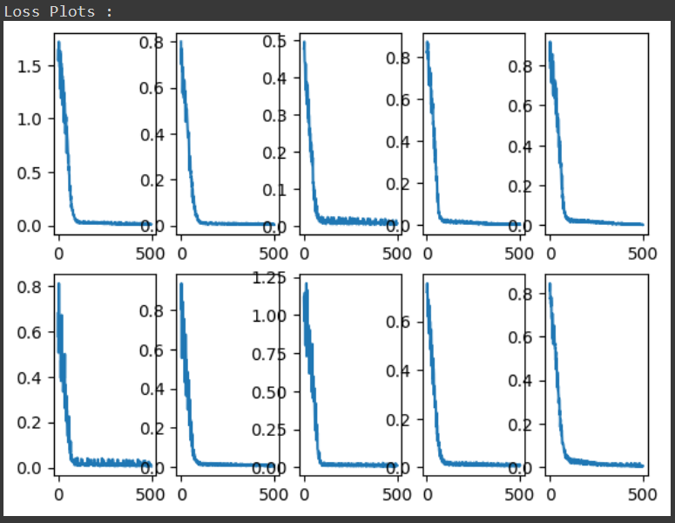
Results and Loss Plots - II
We have use Mean Squared Error as the loss function

Slide 11
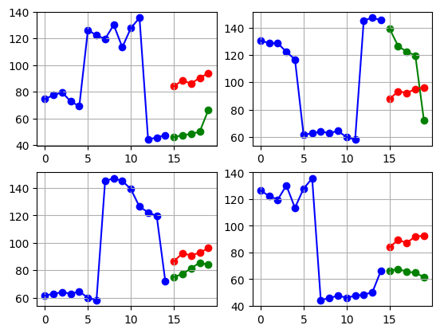
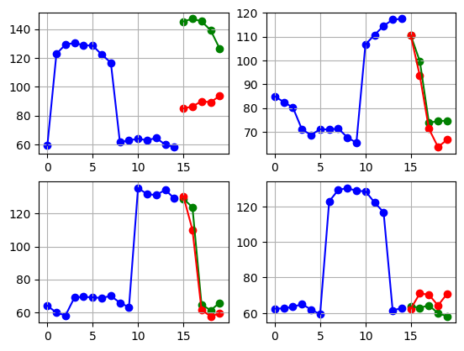
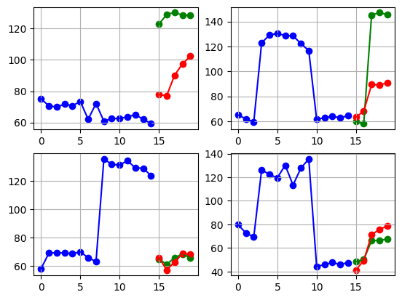
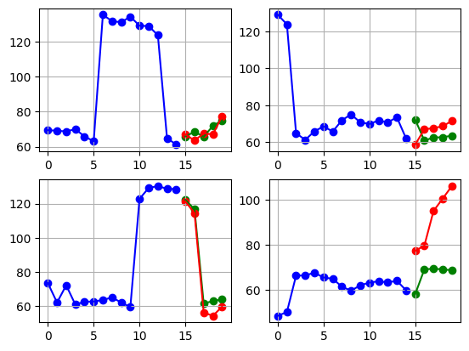
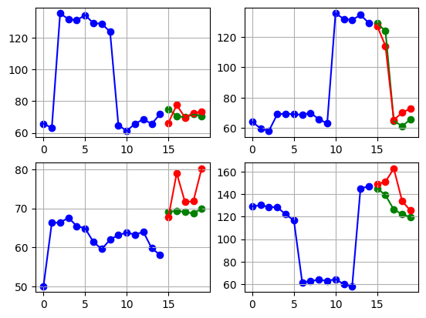
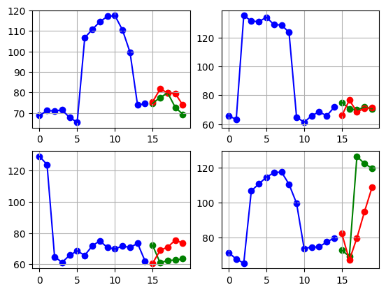
Demonstration
We have used Trend and Seasonality model to predict Electricity Generation of particular states, the one below is of Delhi

Slide 12
Tourism
Dataset

Slide 13
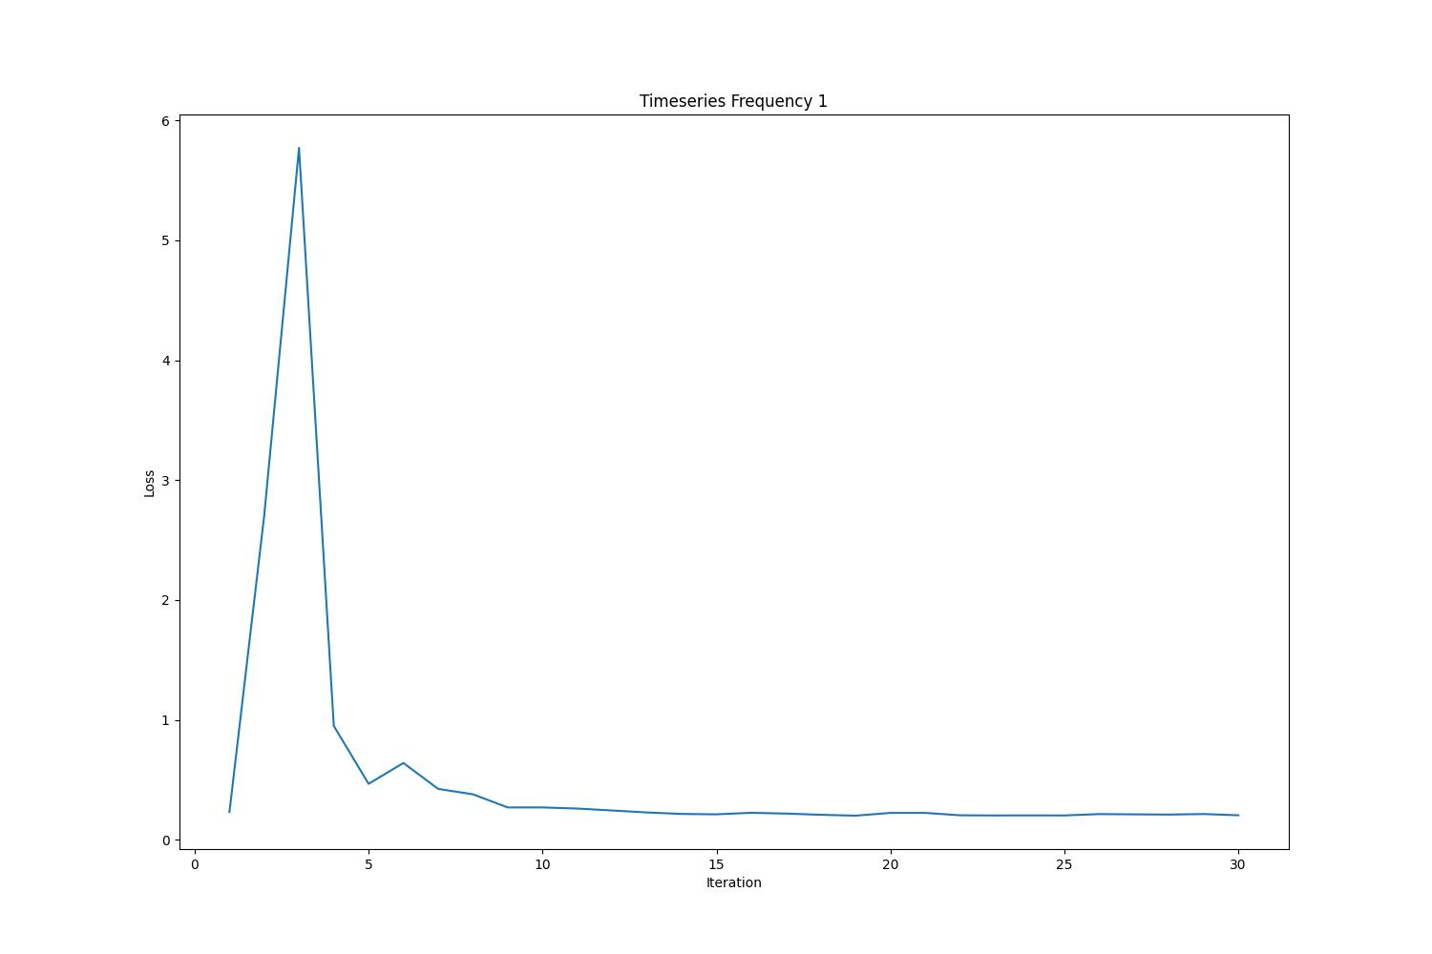
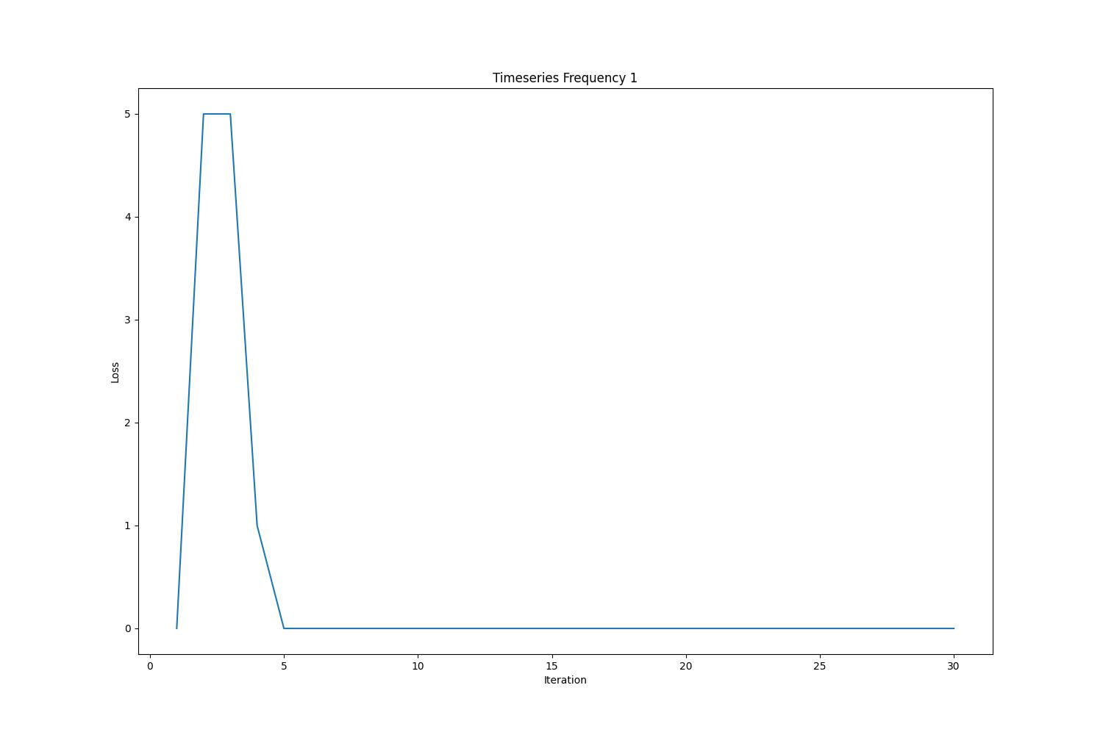
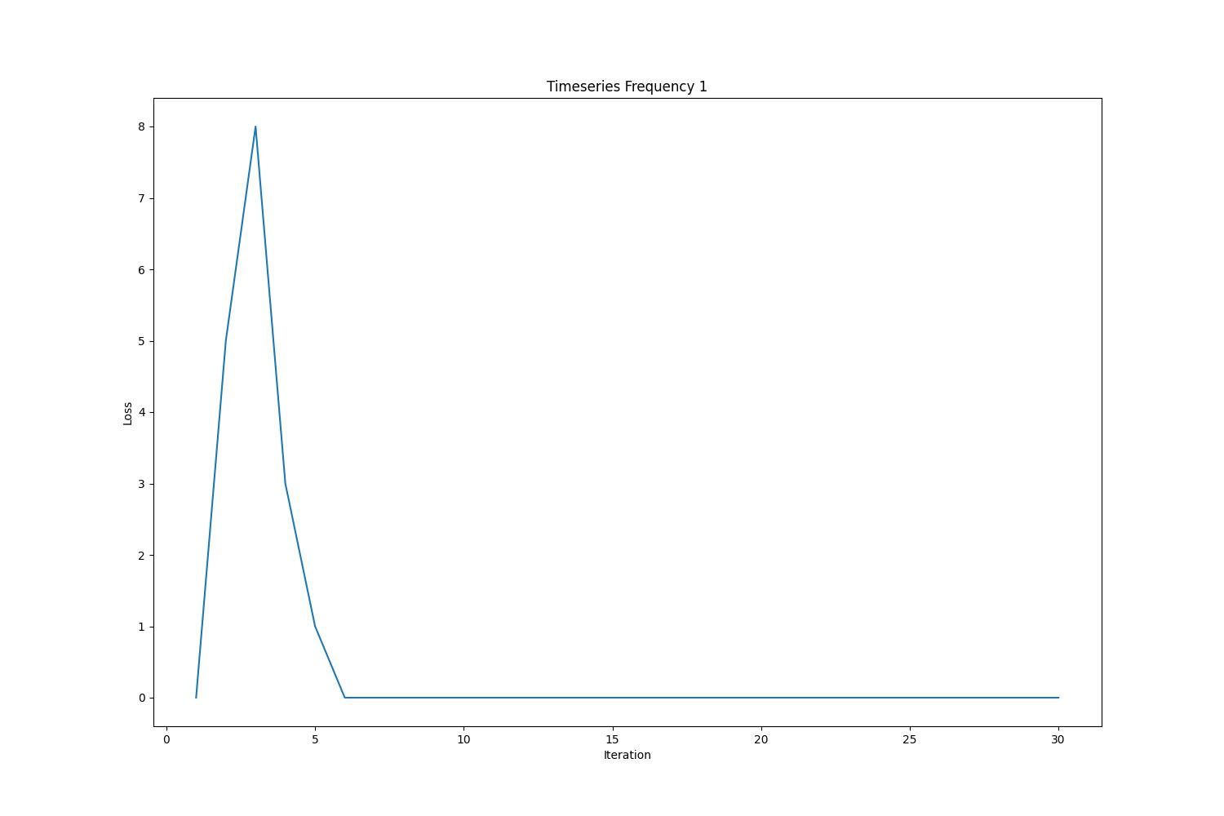
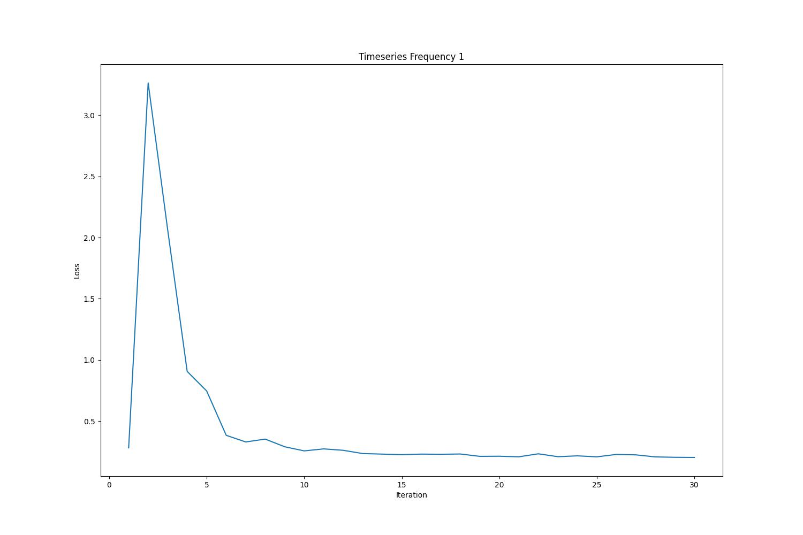
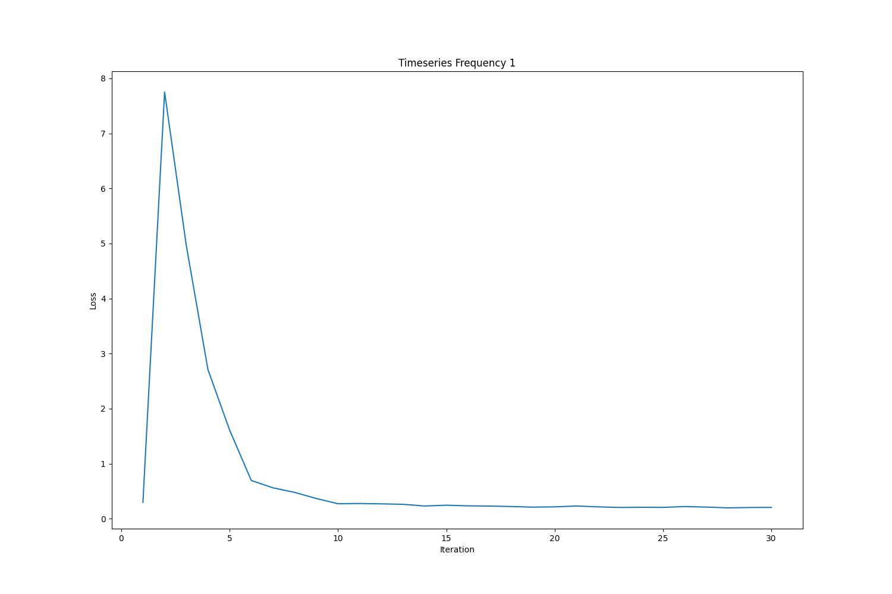
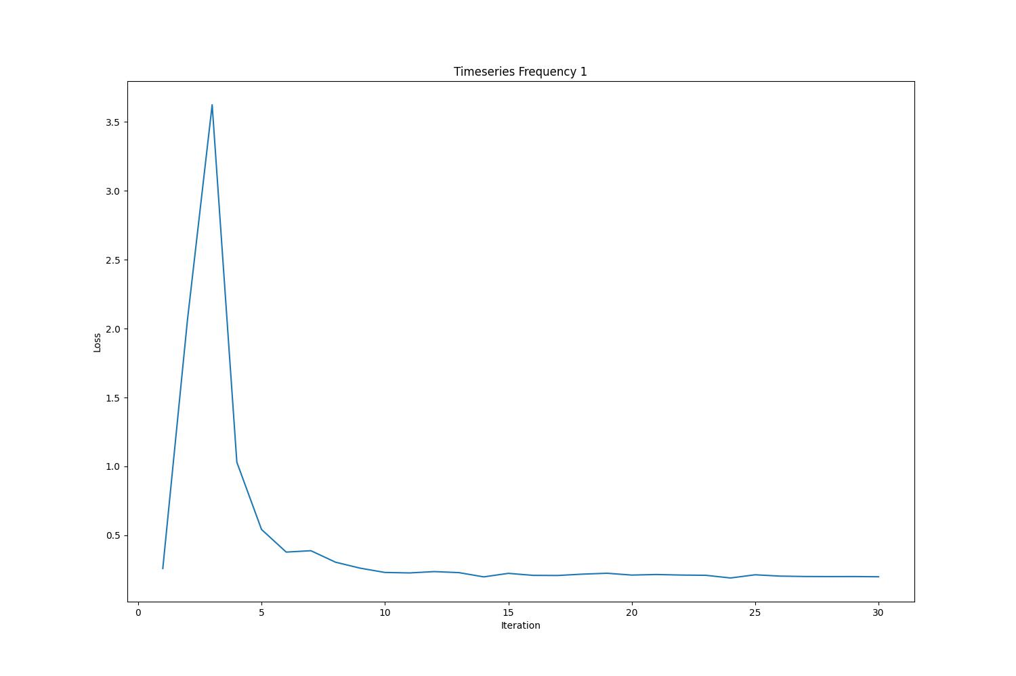
Loss Plots
Tourism – Interpretable Lookback period = 2
Tourism – Interpretable Lookback period = 3
Tourism – Interpretable Lookback period = 4
Tourism – Interpretable Lookback period = 5
Tourism – Interpretable Lookback period = 6
Tourism – Interpretable Lookback period = 7

Slide 14
Recreated Results – Smaller Ensemble
Tourism Dataset
(MAPE) | Yearly | Quarterly | Monthly | Average
G | 22.35 | 16.7 | 19.78 | 19.61
I | 21.31 | 16.32 | 20.16 | 19.26
Ensemble | 21.56 | 16.89 | 19.66 | 19.37
M3 Dataset
(SMAPE) | Yearly | Quarterly | Monthly | Average
G | 16.375 | 9.026 | 13.578 | 12.993
I | 15.961 | 9.219 | 13.409 | 12.863
Ensemble | 16.133 | 8.886 | 13.385 | 12.8013
Lower values better
G refers to Generic, I refers to Interpretable

Slide 15
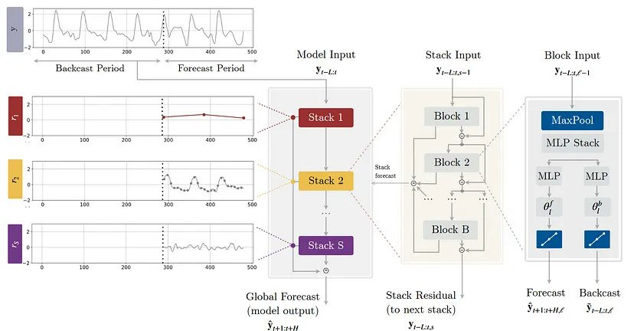
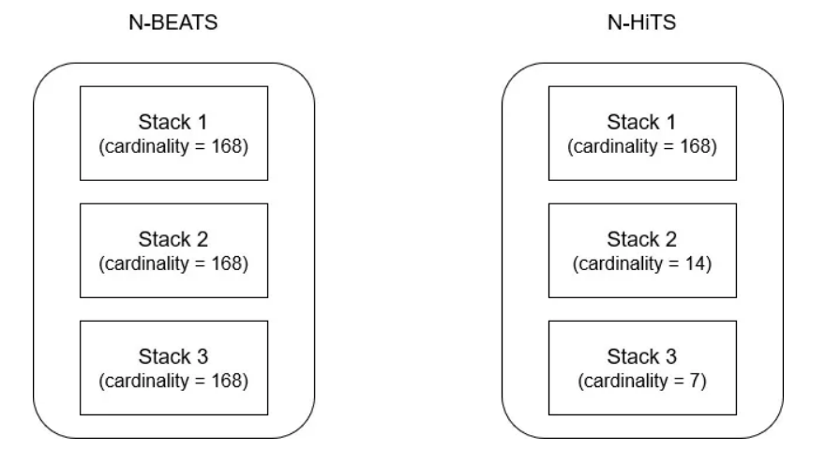
Extra Work - NHits
Key changes to the architecture:
Multi rate sampling through the MaxPool layer – larger kernel translates to greater emphasis on long-term effects
N-HiTS uses hierarchical interpolation, where each stack has what they call an expressiveness ratio (the number of predictions per unit of time)

Slide 16
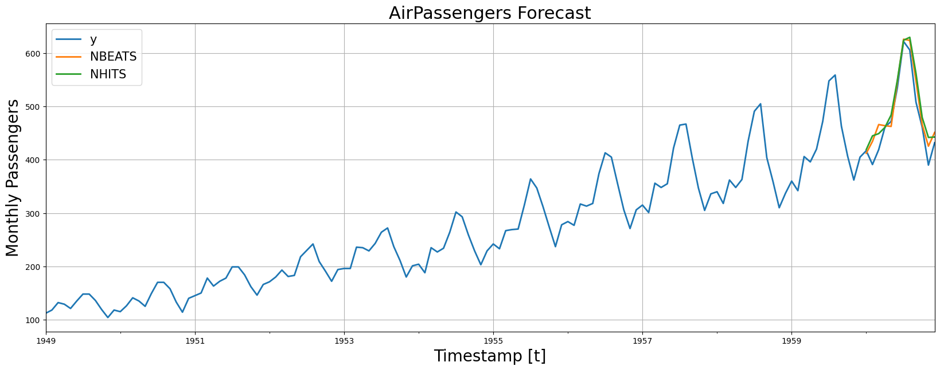
NHITS vs NBEATS
 | MAPE | sMAPE
NHITS | 0.04534 | 0.0488
NBEATS | 0.05109 | 0.04365

Slide 17
Thank You!

